Slide 1

Welcome!
In this experiment, you will be performing an orientation matching task. On every trial, you will be briefly presented with two patches of orientation and a checkerboard (like below) overlaid on top of two objects.
Your task is to report whether the orientations of the two patches match while ignoring the checkerboard.
There will be a total of 4 blocks of trials. Each block has 80 trials and the entire experiment will last between 20 to 30 minutes. You will be able to take breaks in between blocks.

Slide 2
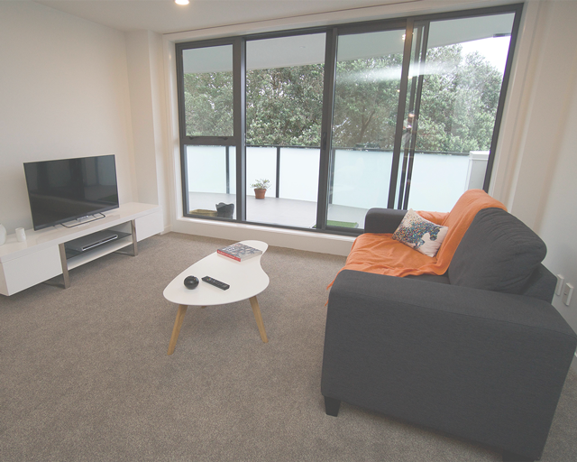
+
+
+
Display 1
Display 1: Fixation
A fixation cross will appear in the middle of the screen, indicating the start of a new trial
No response is necessary, please keep your eyes fixated on the cross

Slide 3
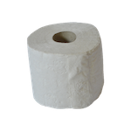
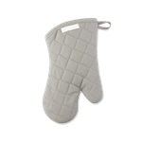
+
+
+
+
+
+
Display 1
Display 3
Display 2
Display 2: Scene
An image of a scene will then appear in the middle of the screen
Again, no response is needed and keep maintaining fixation on the cross

Slide 4
+
+
+
+
+
+
Display 2
Display 4
Display 3
Display 3: Objects
Two objects will appear on either side of the fixation
No response is needed and keep maintaining fixation

Slide 5
+
+
+
+
+
+
Display 3
Display 5
Display 4
Distractor
Two targets
Display 4: Targets
Two small target circles with vertical slanted lines will briefly appear, one in the center and the other on one of the objects
Your task is to indicate whether the two circle targets match in orientation
The above is an example of when orientations match
Ignore the checkerboard circle
The circles are only flashed for a very short time, so pay attention

Slide 6
+
+
+
+
Display 4
Display 5
Display 5: Objects & Scene
Since the targets only appear briefly, try to remember whether the orientations match or not
If the two match, press the f key
If the two are different, press the j key
If you did not see the orientations, take your best guess

Slide 7
+
+
+
+
+
+
+
+
+
Display 1
Display 2
Display 3
Display 4
Display 5
Experiment Sequence
A quick recap. This is the experiment sequence. Maintain fixation on the cross throughout the experiment and report whether the two circle targets are the same or different.
If the two are the same orientation, press the f key.
If the two are different in orientation, press the j key.

Slide 8
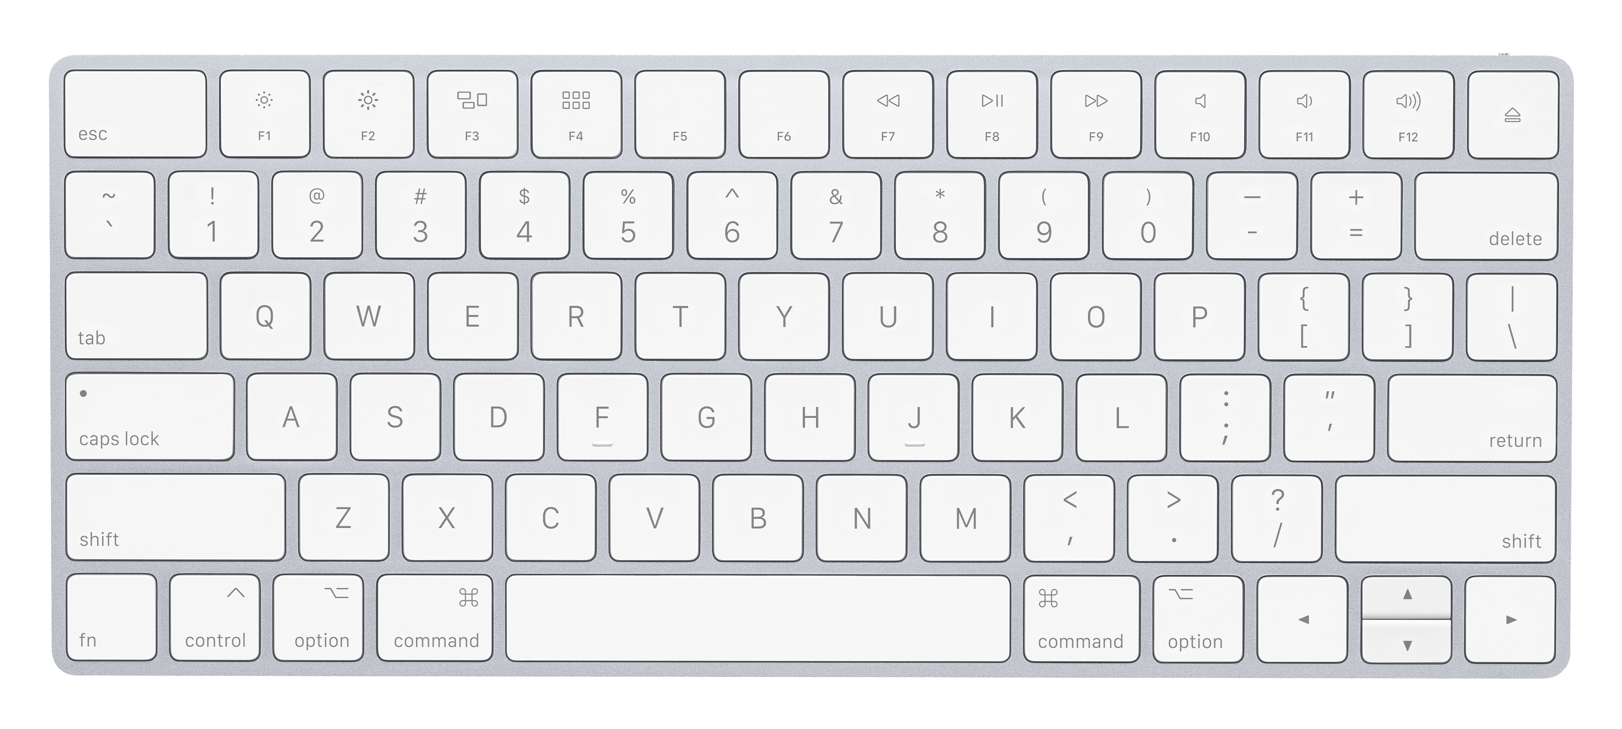
Practice Trials
Ready for some practice trials?
The first half of practice will be slow paced to get you familiarized with the task.
Keep your left index finger on the f key and your right index finger on the j key during the entire experiment.
Also, please keep maintaining fixation and respond as quickly and as accurately as possible.
Notes:
Write about the red fixation feedback

Slide 9
Good Job! You finished practice.
Now, get ready for the real experiment.
Note: There will be no instructions and the targets will be presented for only a brief period of time.
Press Spacebar to begin the experiment
Notes:
Write about the red fixation feedback

Slide 10
You completed the experiment. Thank you!
Press Spacebar to continue

